Slide 1
Clinical Research Investment Scheme (CRIS)
Information Session
Thursday 12th December 2024

Slide 2
Aims of Session
Introduction to the Manchester BRC including an overview of the organisations structure and its mission.
Highlight the BRC Training and Capacity Building Strategy and its key priorities to support research development and capacity growth.
Overview of the CRIS including:
    Eligibility criteria – who can apply and the requirements for participation.
    Scheme benefits – Opportunities and support available to successful applicants.
    Assessment process – Considerations used by the review panel when evaluating applications.
    Successful awardees in 2024 – Examples of successful projects.
  Outline key timelines and application deadlines.
  Q&A – An opportunity for attendees to ask questions and clarify queries.

Slide 3
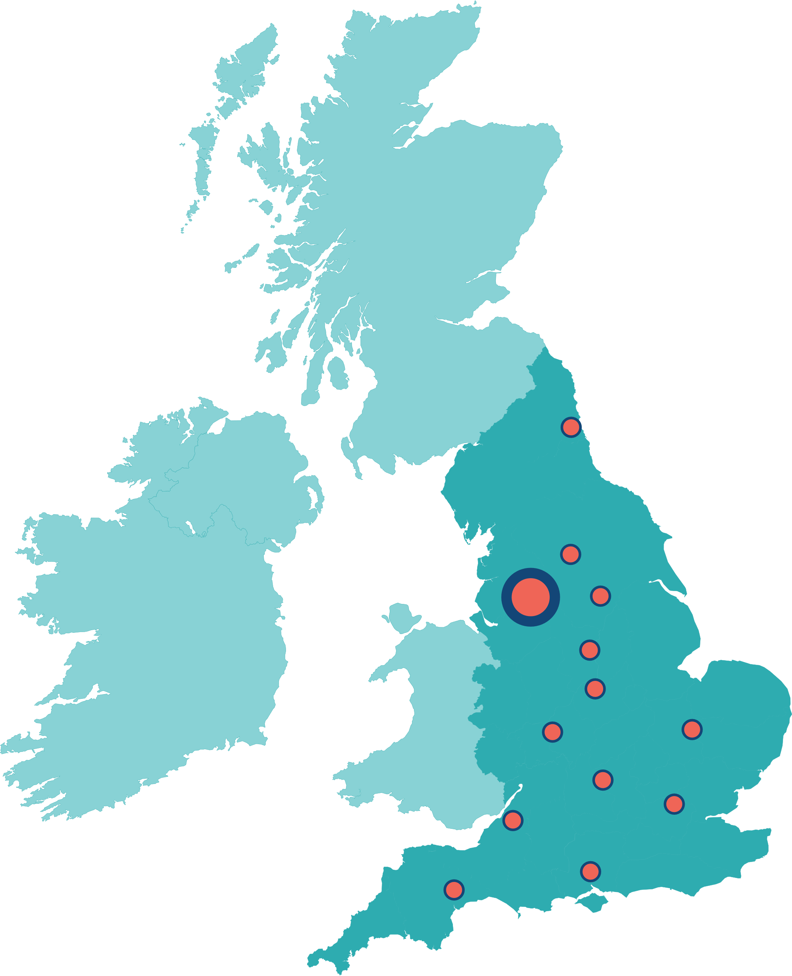
NIHR Biomedical Research Centres (BRCs)
Collaborations between Universities and NHS Trusts as leading centres of excellence in experimental medicine
National Institute for Health and Care Research (NIHR) has awarded >£800 million to 20 NIHR BRCs across England (2022–28) through competitive application.
Translate scientific breakthroughs into new treatments, diagnostics and health technologies
Supports people and infrastructure focused on biomedical innovation and early translational and experimental medicine research
Supports capacity building through funded studentships, fellowships and placements and training opportunities
Leverages funding to deliver research with maximum impact
Newcastle
Leeds
Manchester
Sheffield
Nottingham
Leicester
Cambridge
Birmingham
Oxford x2
London x7
Bristol
Southampton
Exeter

Slide 4
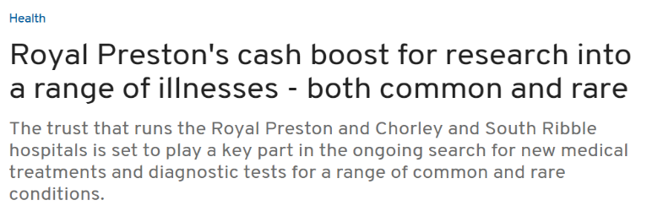
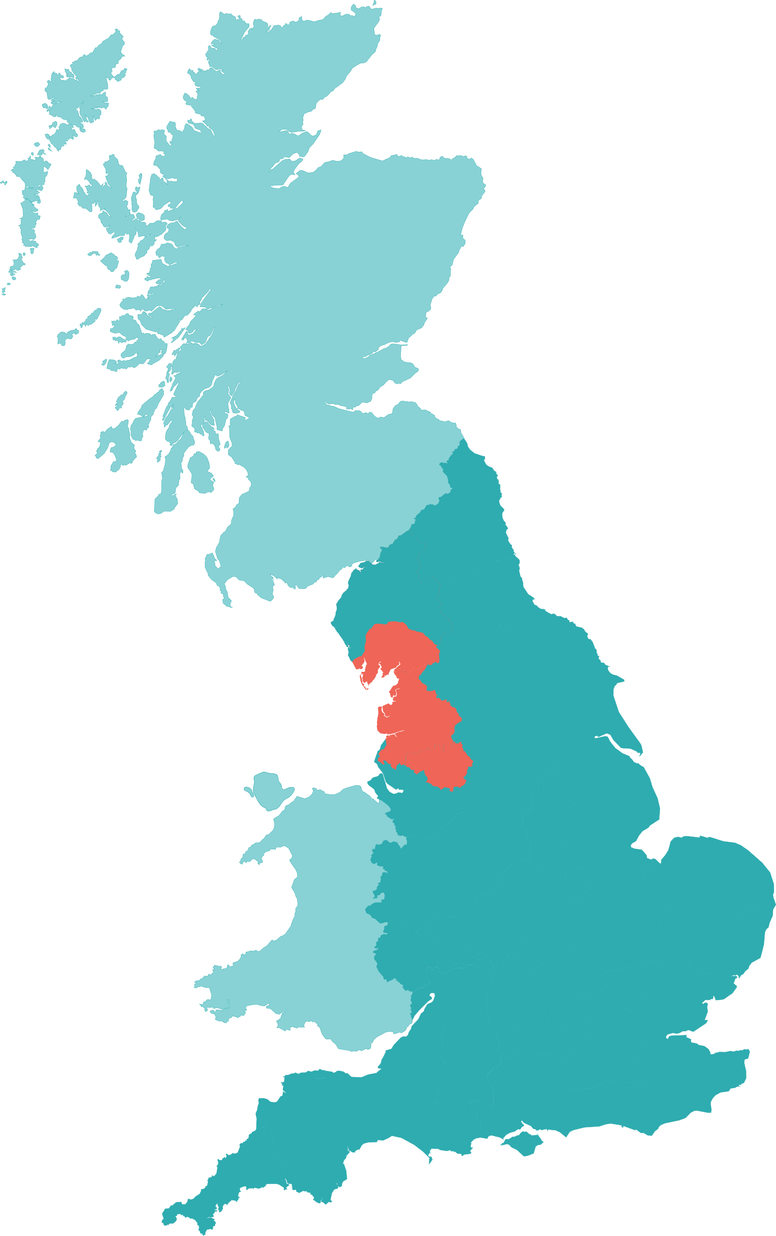
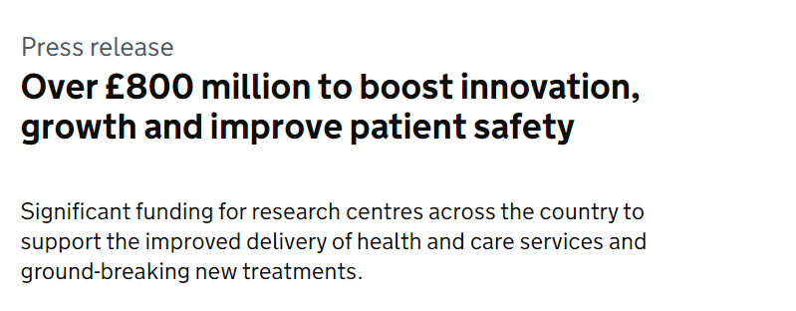


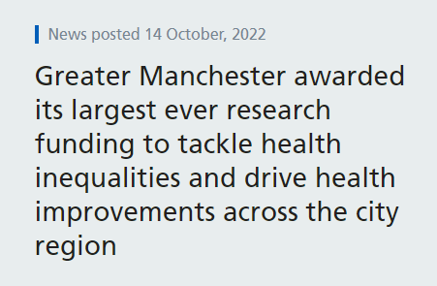
NIHR Manchester BRC 2022-2028
Two-stage competitive application process and interview
Theme and BRC strategy peer review by international panel
More than doubled the size (£28.5m > £64.1m), largest BRC outside of the South-East of England
Wider geography and higher number of Themes funded
Strong emphasis on EDI and Inclusive Research, working with communities with highest need
Notes:
Hosted by Manchester University NHS FT in partnership with The University of Manchester, The Christie NHS FT, Northern Care Alliance NHS FT and expanded the partnership to Lancashire Teaching Hospitals NHS FT, Blackpool Teaching Hospitals NHS FT and Greater Manchester Mental Health NHS FT

Slide 5



Manchester BRC’s vision is to drive personalised health and care for all
Early translational research further into our communities and localities in Greater Manchester, Lancashire and South Cumbria by deepening the meaningful involvement of patients, public and civic partners.
A unique national powerhouse for innovation by combining the world-leading discovery and translational science capabilities of our partnership with a strong research culture centred on a committed, diverse and inclusive workforce.
At scale, the impact of our research through our mature and integrated innovation pipeline in order to achieve measurable improvements in health and wellbeing across all sections of society in our region and beyond.
Embed
Build
Accelerate
Notes:
We aim to:
Deliver an innovative early translational research programme
Transform disease prevention and management, at pace and scale with equity
Involve patients, public and practitioners throughout the research cycle to ensure a cohesive translational research workforce and a Team Science/Research approach.
Research:
Illnesses most relevant to the population of our region
New ways to make correct diagnoses and treat disease
How to prevent ill-health in people, whatever their background or situation.

Slide 6



Manchester BRC’s vision is to drive personalised health and care for all
University
Biomedical Research Centre
Later Research
Steps
Population Healthcare needs
North West
Discover
Develop
Deploy
Health Innovation Manchester
Notes:
Discovery science at University through basic science and early phase research in BRC to later research through other infrastructure and funders towards GM, Lancs and Cumbria needs but this is also a pull from the healthcare needs then informing the discovery science.

Slide 7
Manchester BRC Structure
Basic mechanisms of disease
Prevention and early detection
Person-centred therapies
4 clusters / 13 Themes
Peer support for project/
programme monitoring
Under-Researched Conditions
Hearing Health
Mental Health
Rare Conditions
Cancer
Inflammation
Cancer Prevention
Rheumatic &
& Early Detection
Musculoskeletal
Cancer Precision
P
Diseases (RMDs)
e
r
sonalised
Respiratory Medicine
Medicine
H
ealth &
Dermatology: Cutaneous
Advanced
Ca
r
e
f
o
r
Radiotherapy
all
Inflammation and Repair
Drive integration across themes
Living with
Integrative
Maximise leverage of internal/
external grant funding
& Beyond Cancer
Cardiovascular
Medicine
Advanced Diagnostics
& Therapeutics Catalyst
Next Generation
Phenotyping & Diagnostics
Next Generation Therapeutics
Notes:
ADTC Aims:
To deepen understanding of disease mechanisms, including how inequalities and social factors impact biological processes
To support novel diagnostics
To provide a platform to provide early proof of concept for our novel therapeutics pipeline.
Inflammation
Addresses several of the most common causes of death and disability in our region and nationally, in which prognosis is strongly influenced by deprivation and adverse social determinants.
Under Researched conditions
Research will be undertaken on disorders that have high impact on individuals and families, but where traditionally there has been under-investment.
These problems can often be hidden and people with these conditions can face challenges around access to healthcare.
Cancer
This Cluster addresses emerging challenges and opportunities to improve the lives of all patients with cancer, including people at risk of cancer.
It provides a patient centred approach to research in earlier diagnosis, better treatment and personalised, follow up care.

Slide 8
Manchester BRC Core Infrastructure Team
Strategic funding and emerging areas
Theme Programme and Project Management
Operations and
Contractual adherence
Performance Data and Metrics
Core Team
Digital Infrastructure
Innovations and Strategic Partnerships
Communications and Impact
Inclusive Research:
IRM
PPIEP
EDI
Capacity Building and Education/
Training

Slide 9
Training and Capacity Building
Embed innovative training approaches to build capacity in Experimental Medicine and create a diverse and inclusive BRC Faculty.
Widen access to training across Greater Manchester NIHR Infrastructure, Northern BRCs and Northern Ireland.
Deliver training tailored to individual needs that spans the entire career pathway including undergraduate, postgraduate and post-doctoral training and academic career development which includes allied health professionals.

Slide 10
Training and Capacity Building Strategy Pillars
Academic Programmes​ | Professional Development​ | Careers & Community Building​
Innovative research &/or interdisciplinary training through:​ ​ PhD and Fellow programmes​ Links to Integrated Academic Training (IAT)​ | Clinical Research Investment Scheme (CRIS) for Senior Clinicians who would like to develop their research portfolio.​ ​ Healthcare Professional Placement Scheme offering short flexible placements to Nurse, Midwives, Allied Healthcare Professionals and others with little or no research experience.​ ​ Training Seminar Series offering flexible monthly virtual and in-person training.​ ​ Pre-support application fund to support NMAHPs with career progression and submission for NIHR fellowship. | Coaching, Mentoring & Leadership Scheme for Rising Stars and Early Career Researchers.​ ​ PhD Buddy Scheme for students in training.​ ​ Active online communities of practice across GM and wider NIHR network.​ ​ Supporting experimental medicine research for all - Team Research & non-academic careers.​ ​ Promotion of careers & communication of training opportunities.​
Equality, Diversity and Inclusive Research​

Slide 11

Clinical Research Investment Scheme (CRIS)
Aims of Scheme:
To invest in and increase the capacity of research-qualified healthcare professionals focussing on experimental medicine / early phase translational research across the BRC regional partnership.
To provide an opportunity to individuals with prior research experience who are not currently engaged in research but wish to strengthen their skills and establish a sustainable career in early phase experimental medicine.

Slide 12
Eligibility Criteria
Professional Role:
Must be a registered HCP in a senior role such as NHS AfC Band 7+ or Consultant level.
Hold a substantive contract at an MBRC partner Trust.
Research Experience:
Hold a PhD, MD, or equivalent research experience, such as 3 years of consolidated research time where you’ve been the intellectual drive behind a project and achieved strong outputs.
Career Stage:
There are no restrictions based on age or the time since obtaining your PhD or MD.
Applicants without a significant break in research activity must clearly articulate the added value this award would bring to their career.

Slide 13
Eligibility Criteria
Current Research Involvement:
Should not be undertaking substantive research (less than half a day per week dedicated to research activities).
Professional Expertise:
Be working at a senior level with specialised knowledge and have demonstrated some capacity for professional independence and leadership.
Organisational Support:
Have the support of your NHS Trust (or equivalent) who can guarantee your research time will be protected during this grant.
A commitment from your NHS Trust to protect your research time beyond the grant period.

Slide 14
What We Offer
Protected Research Time:
Salary contribution of 0.2FTE per year to ensure protected research time.
Project Funding:
Up to £5,000 (including VAT) for small-scale research consumables.
Training and Mentorship:
Comprehensive support to design and run clinical trials or other translational/EM studies in collaboration with the NIHR Manchester Clinical Research Facility (CRF).
Core Infrastructure and Expertise:
Access to specialised resources and training including Patient and Public Inclusion and Engagement (PPIE), Inclusive Research, Equality, Diversity and Inclusivity (EDI), Digital and Methodological advice.

Slide 15

Project Areas
We are looking for experimental medicine / early phase translational research projects that are:
  Focused on your area of interest and expertise.
  Align with BRC strategic objectives and themes, ensuring a mutually beneficial collaboration.
This award is designed to build your skills in early phase trials through hands-on, on-the-job training.
Proposals that complement existing early-phase trials or projects within the Manchester BRC/CRF would be welcomed and encouraged, as they can provide additional support and resources for your research.

Slide 16
Examples of Potential Project Ideas
Interest: Gene sequencing and polygenic risk scores (focus on developing and utilising polygenic risk scores which assess genetic risk factors for developing medical conditions.
Approach: Collaborate with Professor Andrew Morris and leverage datasets from his work within the Inflammation cluster.
Analysis: In the middle of year 2 you will start to write a grant on the type of area you wish to pursue in further research.
Link to Research Facilities: Engage with commercial clinical trials or related fields (e.g., rheumatology) to integrate research with real-world applications.
Mentorship and Collaboration: Link in with Ben Parker as a mentor and work with the CRF on clinical trials (e.g., rare conditions)
Training: Participate in investigator meetings and gain in-depth knowledge of trial processes to further your skills in translational medicine.
Future Work: Pursue opportunities as a Co-Investigator on trials and expand into broader EM projects.
Notes:
Cardiovascular disease prediction - > could link to RA

Slide 17
Cross-Cutting Themes
Polygenic Risk Scores - Exploring genetic risk factors and their role in predicting the likelihood of developing medical conditions.
Adherence - Investigating factors that influence patient adherence to treatment plans and interventions.
Digital Interventions or Data Resources – Harnessing digital technologies and data resources to improve health outcomes and research efficiency.
Under-Represented Communities and Health Inequalities - Addressing disparities in healthcare access and outcomes among under-represented communities.
Fatigue - Research the causes, impact, and management of fatigue in various patient populations.
Adult and children’s research - Focusing on both adult and paediatric populations in EM and clinical research.
Patient and Public Involvement and Engagement (PPIE) - Ensuring meaningful patient and public involvement in the design, conduct, and dissemination of research.

Slide 18

Successful CRIS Awardees in 2024
Awardee | Project | BRC Theme
Paul Marsden, Honorary Senior Lecturer & Consultant Physician in Respiratory Medicine, at MFT | Neural Correlates of Low Dose Opioid Therapy in Refractory Chronic Cough. | Respiratory Medicine
Laura Jane Forker, Honorary Senior Lecturer in Cancer Sciences & Consultant Clinical Oncologist at The Christie | A phase 1 study of carbogen and nicotinamide with stereotactic MR guided adaptive radiotherapy (MRgART) for pancreas cancer. | Advanced Radiotherapy
Safwaan Adam, Honorary Senior Lecturer & Consultant Endocrinologist at The Christie | Using home-based salivary testing, predictive modelling and a national registry to improve screening, risk prediction and understand long-term health outcomes. | Living With and Beyond Cancer (LWBC)
Kathryn Banfill, Consultant Clinical Oncologist at The Christie | Optimising cardiovascular health in patients with lung cancer – Christie Charity funded. | LWBC, Advanced Radiotherapy, Integrative Cardiovascular Medicine.
Emma Searle, Honorary Senior Lecturer and Consultant Haematologist at The Christie | Trial of Prevention of ImmunoCytokine Adverse events in MyeLoma (TOPICAL) – Christie Charity funded. | Cancer Precision Medicine
Paul Sutton, Honorary Senior Lecturer in Cancer Sciences and Consultant Colorectal, Pelvic & Peritoneal Surgeon at The Christie | Studying the immune response to total neoadjuvant therapy in locally advanced rectal cancer – Christie Charity funded. | LWBC, Advanced Radiotherapy, Cancer Precision Medicine.

Slide 19

Assessment Criteria
The CRIS review panel will assess applications based on the following:
Commitment to Future Integrations: Demonstrated dedication to applying newly acquired skills in your work and research.
Research Quality and Alignment: The quality of the proposed research and training, as well as its alignment with BRC themes and strategic objectives.
Supportive Environment: The availability of a conducive environment for skill and research development. Appropriateness of the proposed academic support and mentorship.
Host Trust Commitment: A clear, written commitment from your host Trust to continue supporting your translational / EM studies and trials beyond the funding period (e.g., letter of support).

Slide 20
Lessons Learned & Hints/Tips
The CRIS review panel will assess applications based on the following:
The finances had been clear about what the award was covering, and where in-kind contribution had been sought – speak with your finance people to get accurate costings.
Ambition is good but be prepared to be realistic with what can be achieved in 0.2FTE, and what the outcome of the award will be.
  Explaining the background and other work is good, but you need to be able to differentiate that from the work completed with the award.
Don’t leave the PPIE, EDI or IR as an added extra. Incorporate it/consider it as part of your application – obviously you need to be clear when it is relevant, and when it isn’t.
Contact BRC theme/cluster leads as soon as you know what you wish to do, so it can be aligned with the BRC. It may be appropriate to have them as mentors/supervisors or someone from the BRC.
Be aware the panel who review are diverse – explain your science to an audience that has scientific knowledge but doesn’t know your area as well as you.
Approach your Trust/sponsor for the commitment as soon as possible – give them the heads up you intend to submit.

Slide 21
Key Dates
Process | Date
Expression of Interest (EOI) Opens | Monday 2 December 2024
EOI Submission Deadline | Monday 3 February 2025
EOI Review Panel Meeting (triage applications) | Monday 17 February 2025
Full Application Opens | Monday 24 February 2025
Full Application Closes | Friday 2 May 2025
Review Panel Meeting | Monday 12 May 2025
Short Interviews Held | Monday 19 May 2025
Awardees Start Scheme | No later than January 2026

Slide 22

Next Steps
Identify you Research Area: Determine your area of interest and how it aligns with the BRC.
Engage with Key Contacts: Speak with MBRC Cluster or Theme Leads and connect with others involved in the MBRC, such as the Theme Project Managers or Capacity Building Leads.
Explore Opportunities: Consider how your expertise fits with ongoing early-phase trails within the MBRC and CRF, as well as areas they aim to develop.
Secure a Mentor/Supervisor: Find a mentor or supervisor who can sponsor you both within the BRC and at your host Trust.

Slide 23
Wider Context
NIHR Senior Clinical and Practitioner Research Award (SCPRA)
  Provides up to 5 years of funding at post-doctoral level to support engagement in high-quality research activities.
  Applicants can propose a broad range of research activities tailored to their career development needs.
  Funding includes between 20% and 50% of the award holder’s salary, as well as training and development costs and contributions to research activity costs (up to £100K over 5 FTE years).
  The award launches annually in October.
  NIHR Senior Clinical and Practitioner Research Award (SCPRA) - Round 1 | NIHR

Slide 24
Any Questions?

